Slide 1
2019 MMILAB.DIP Seminar Week1(12/31~1/5)
20151415 김성수

Slide 2
Contents
Digital Image
Intensity Transform -negative, log, gamma, contrast stretching, bit slicing
Affine Transform
Color Transform
- Reason of various Color model, RGB, Ycbcr, CMY, HSI

Slide 3
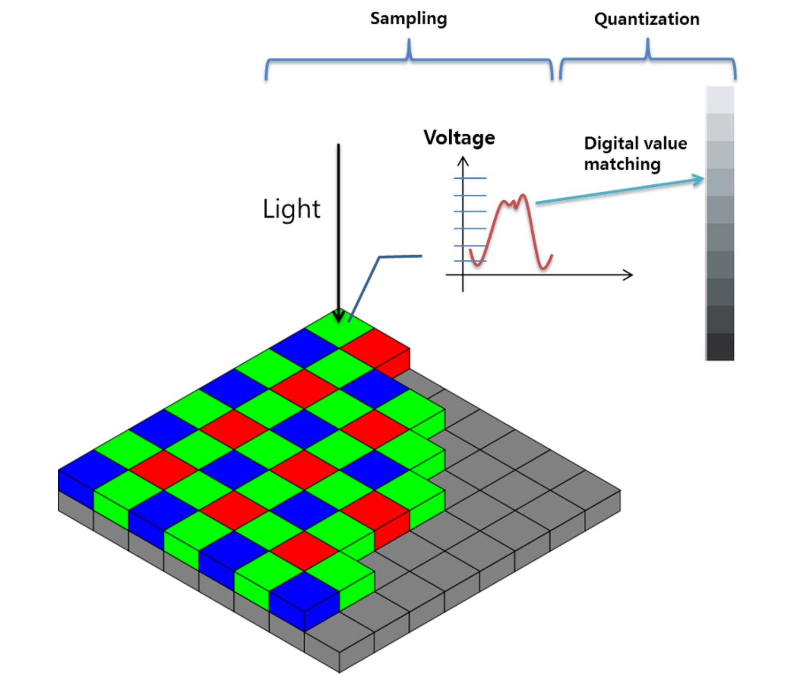
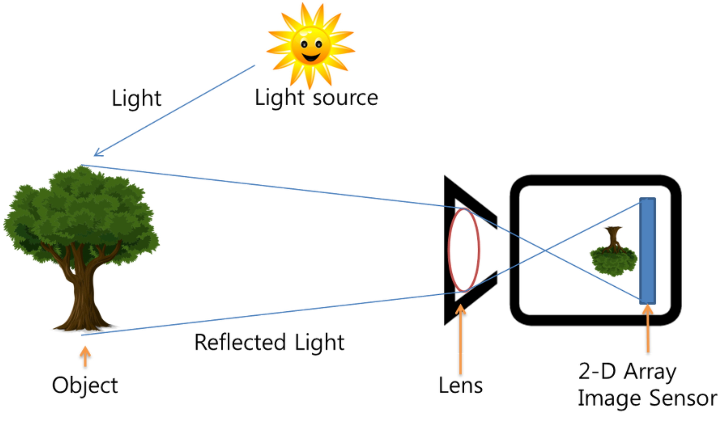
Digital Image
CCD(charge coupled device), CMOS
Energy -> Signal

Slide 4
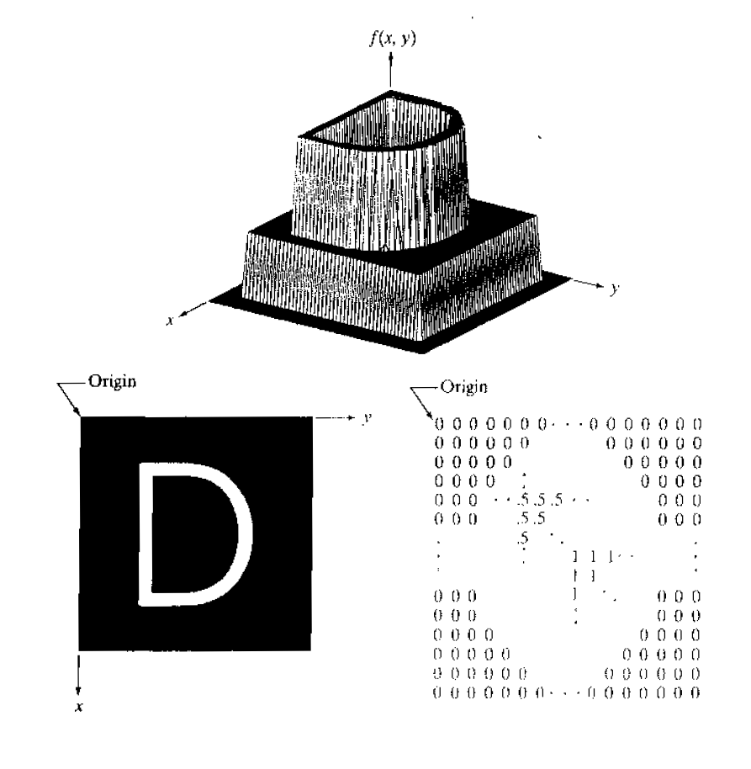
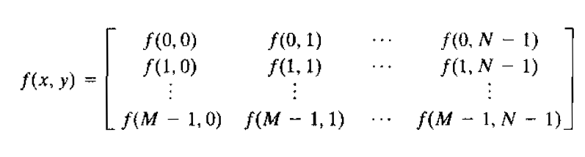
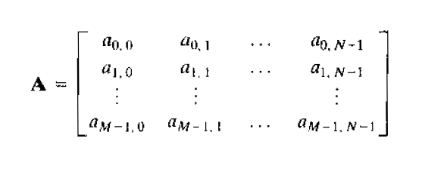
Digital Image

Slide 5
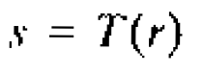
Purpose of Intensity transformation
“Process of manipulating an image so that the result is more suitable than the original for a specific application”
→ Enhancement
Transformation Function
Intensity of g at any point of (x,y)
Intensity of f at any point of (x,y)

Slide 6
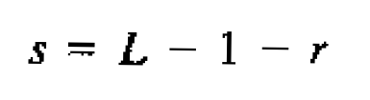
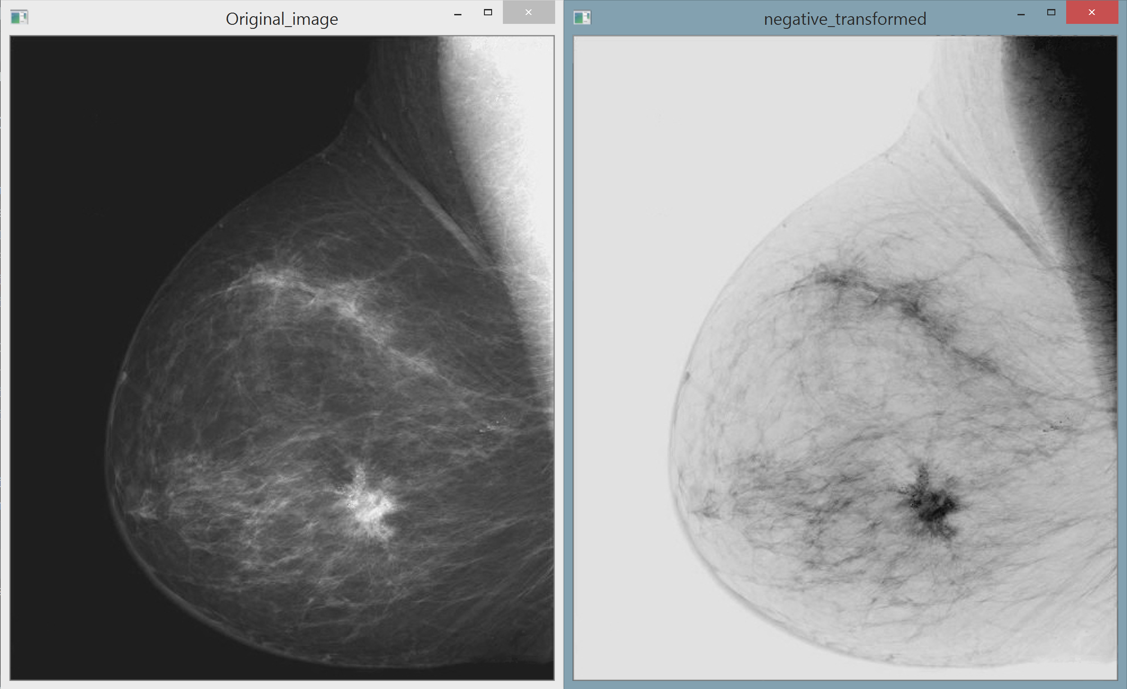
Intensity Transform – Negative(Grayscale)
For Image Intensity range[0,L-1]
Max intensity

Slide 7
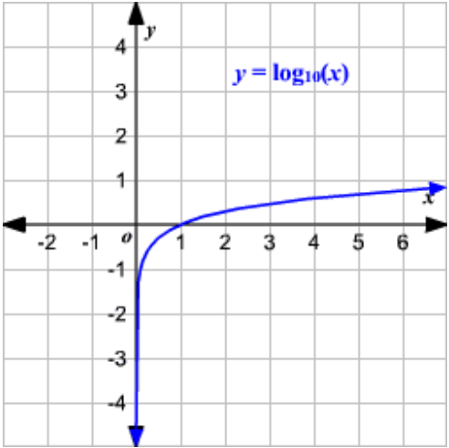
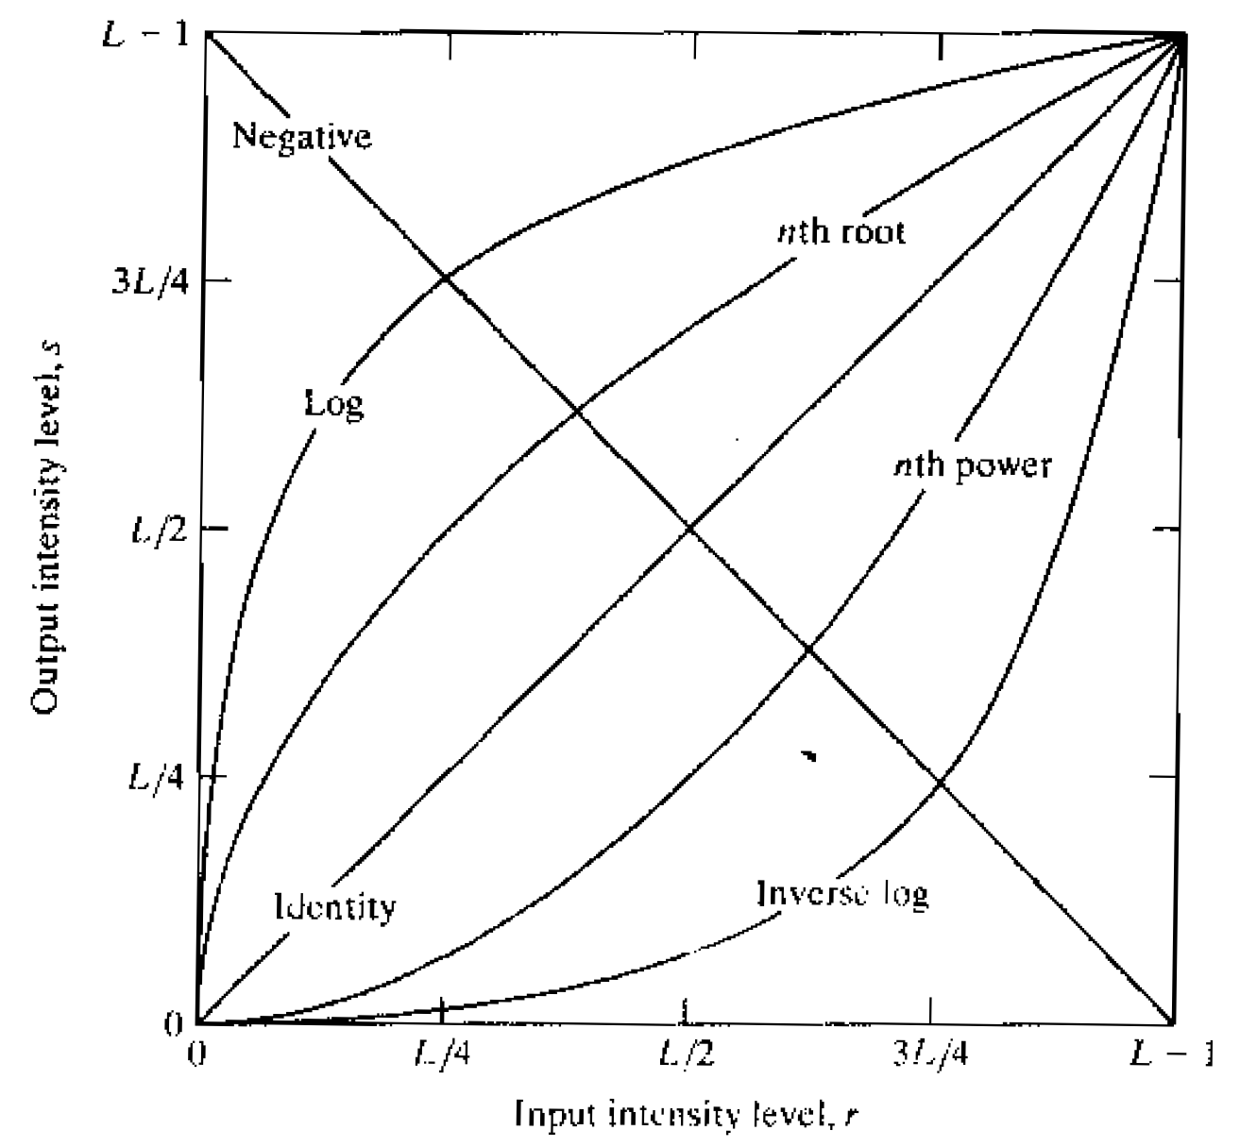
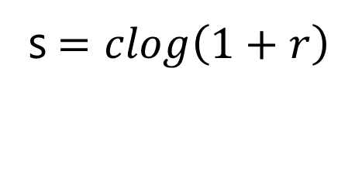
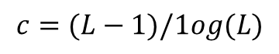
Intensity Transform- Log transformation
s$=clog\left(1+r\right)$
Meaning?
: Mapping a narrow range of low intensity values of input into a wider range of output values
Mapping a wider range of high intensity values of input into a narrow range of output values
$$c=(L−1)/1og(L)$$

Slide 8
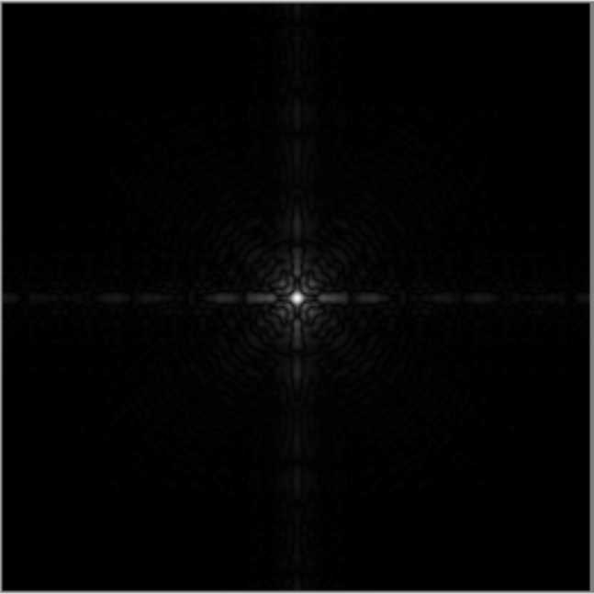
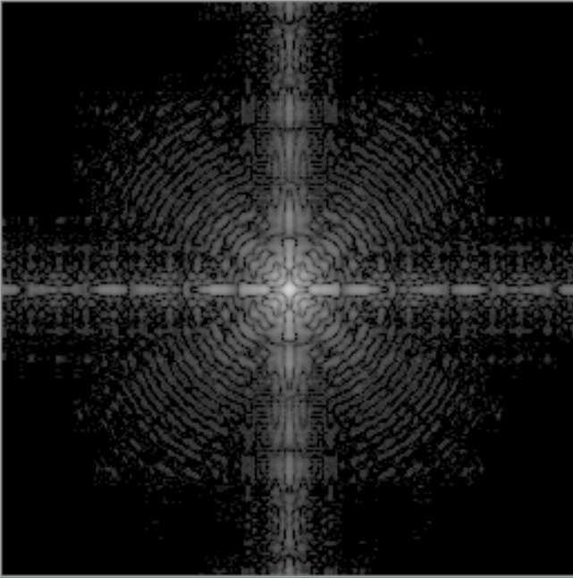
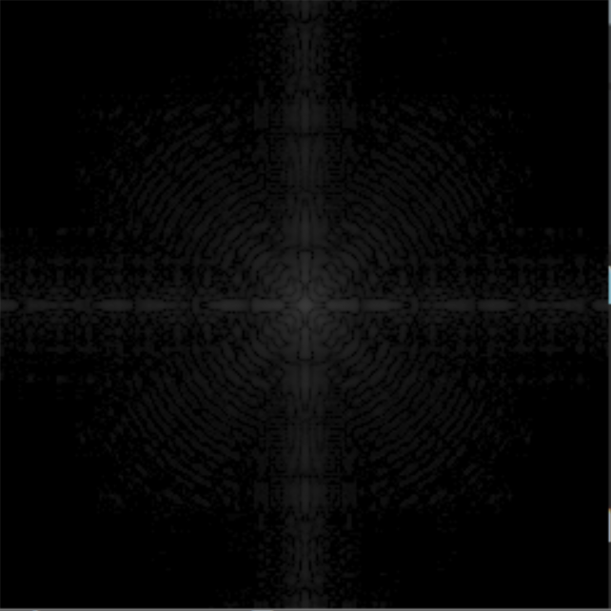
Intensity Transform –Log Transformation
Original
Log base=3
Log base=10
Why useful?
Can show more Details
Compress the dynamic range of images with large variation in pixel value

Slide 9
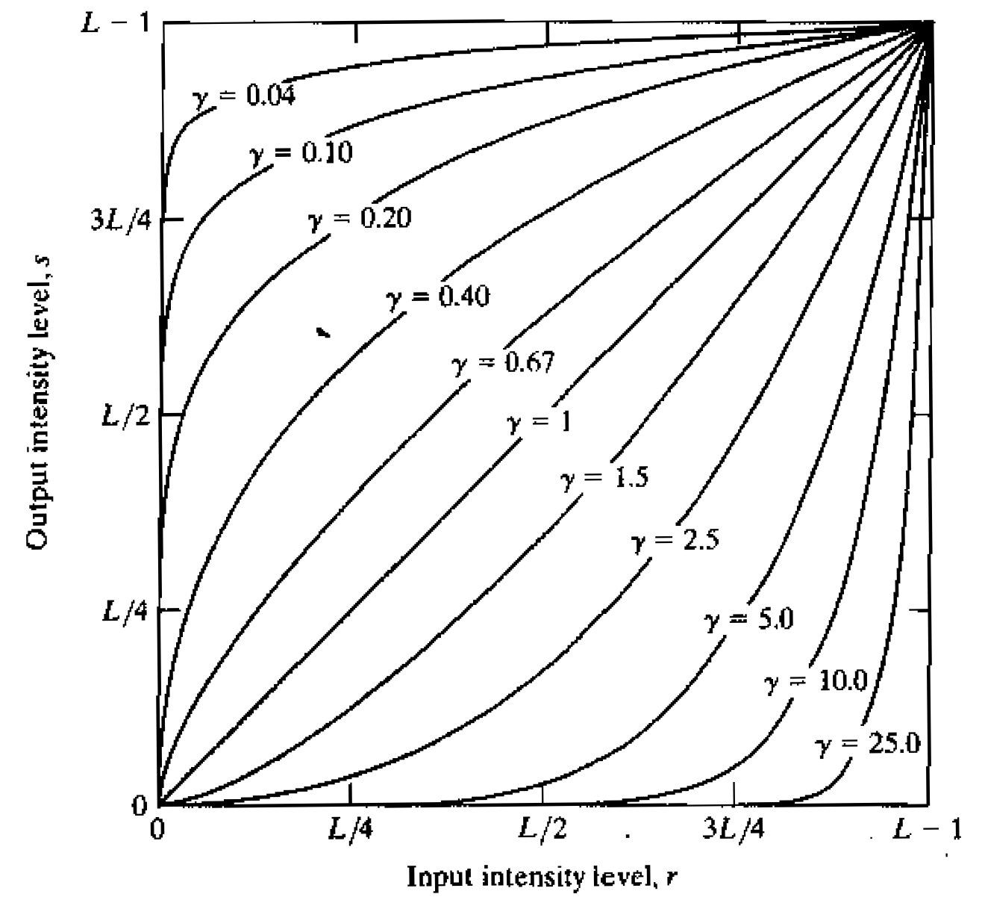
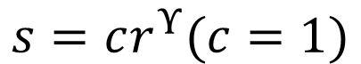
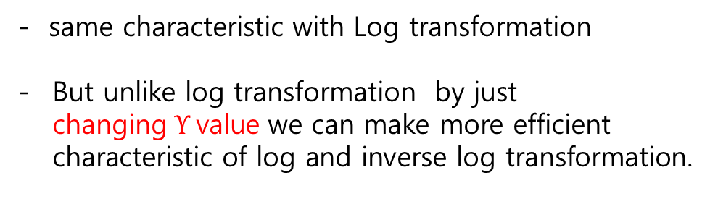
Intensity Transform – Gamma Transformation
$$s=cr^{Υ}(c=1)$$
Meaning?
- same characteristic with Log transformation
But unlike log transformation by just changing$Υ$value we can make more efficient characteristic of log and inverse log transformation.

Slide 10
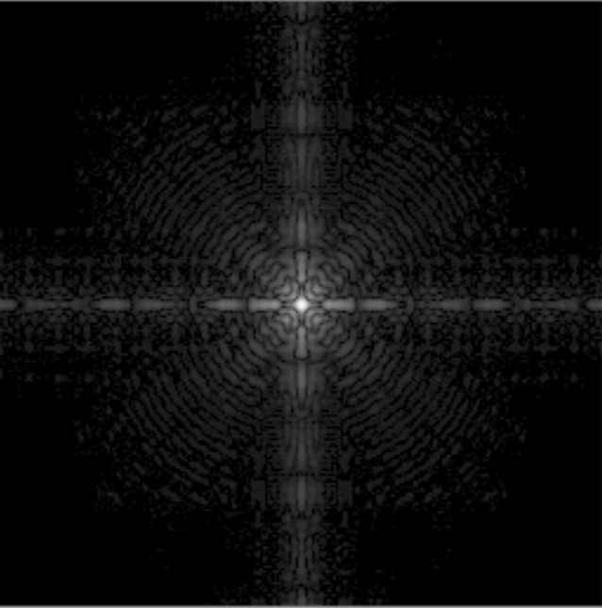
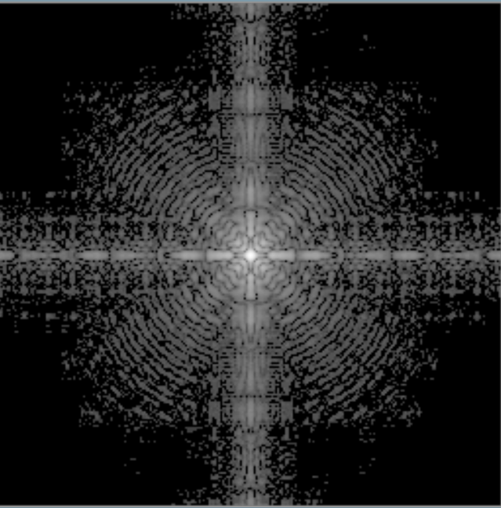
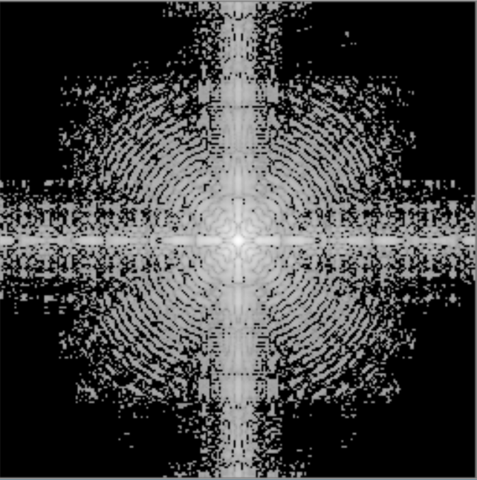
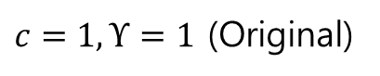
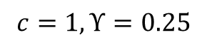
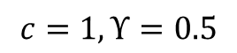
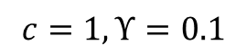
Intensity Transform –Gamma Transformation
$c=1,Υ=1$ (Original)
$$c=1,Υ=0.5$$
$$c=1,Υ=0.25$$
$$c=1,Υ=0.1$$

Slide 11
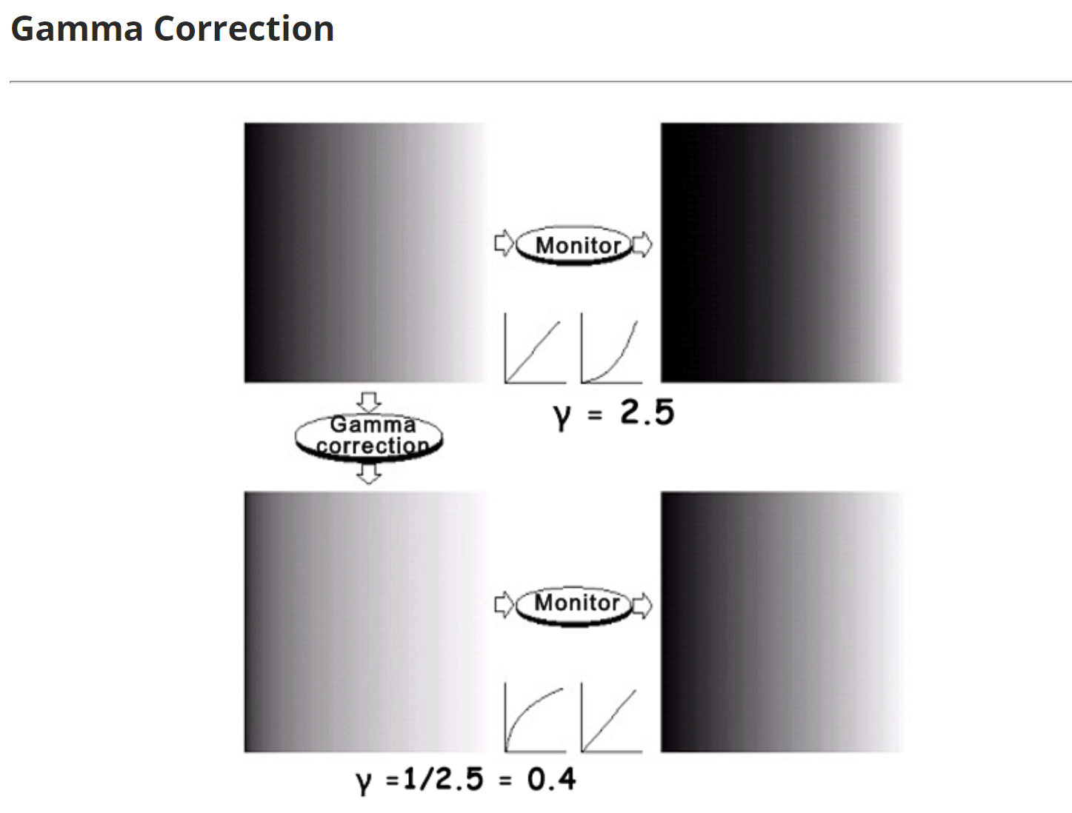
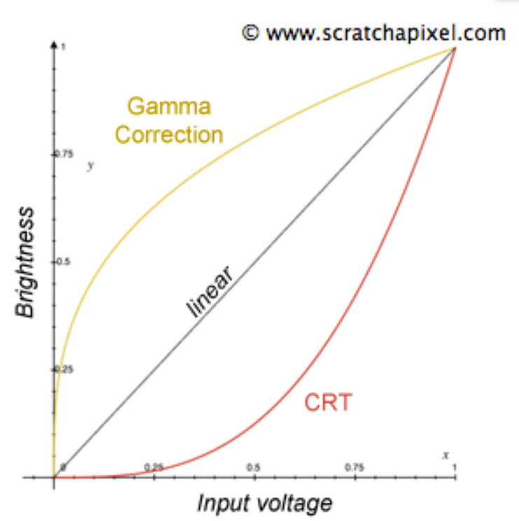
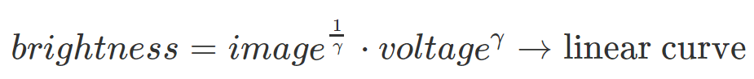
Intensity Transform –Gamma correction
Eg) CRT monitor

Slide 12
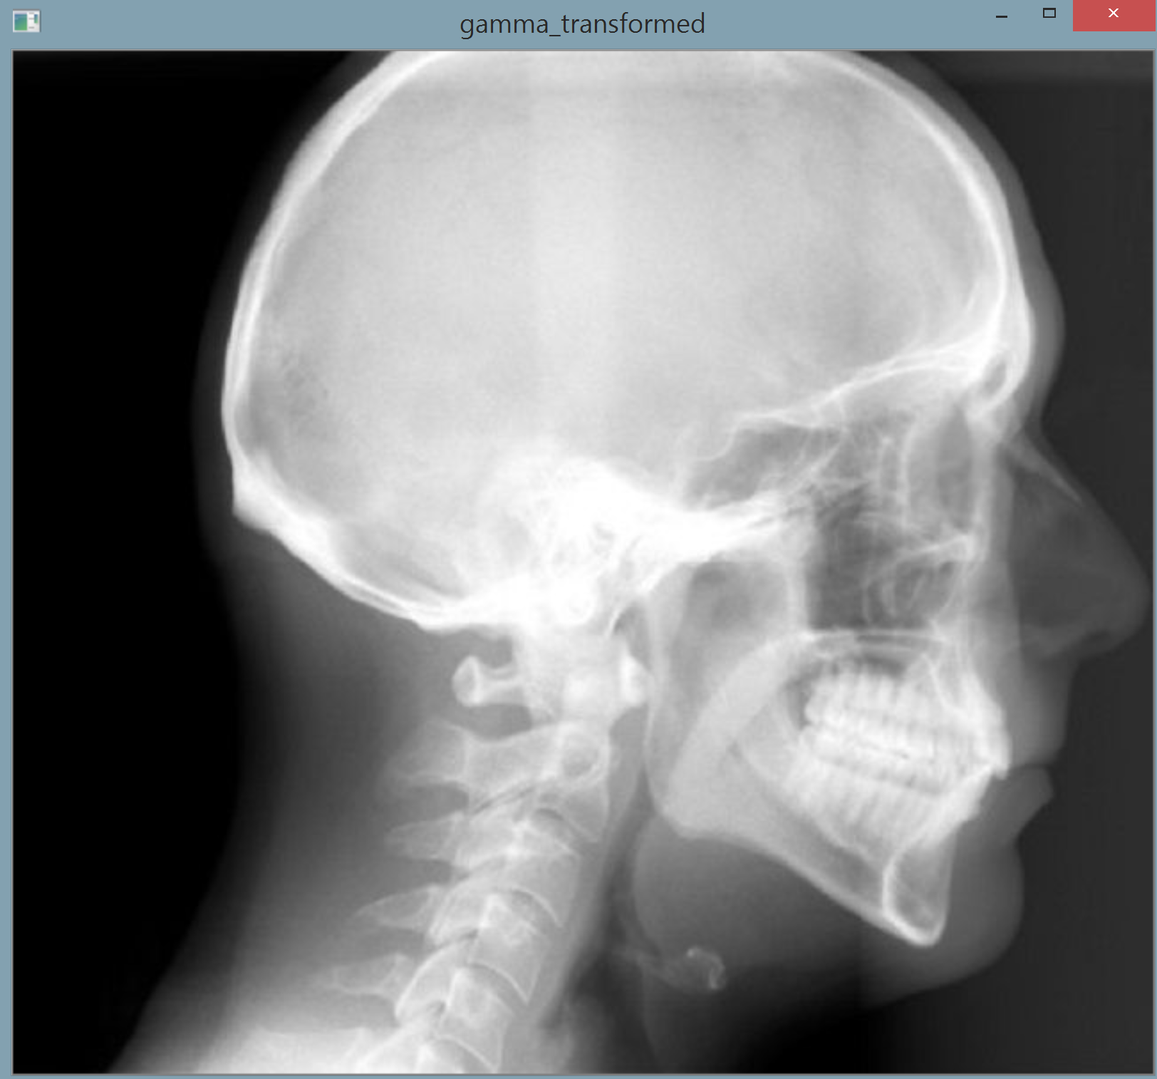
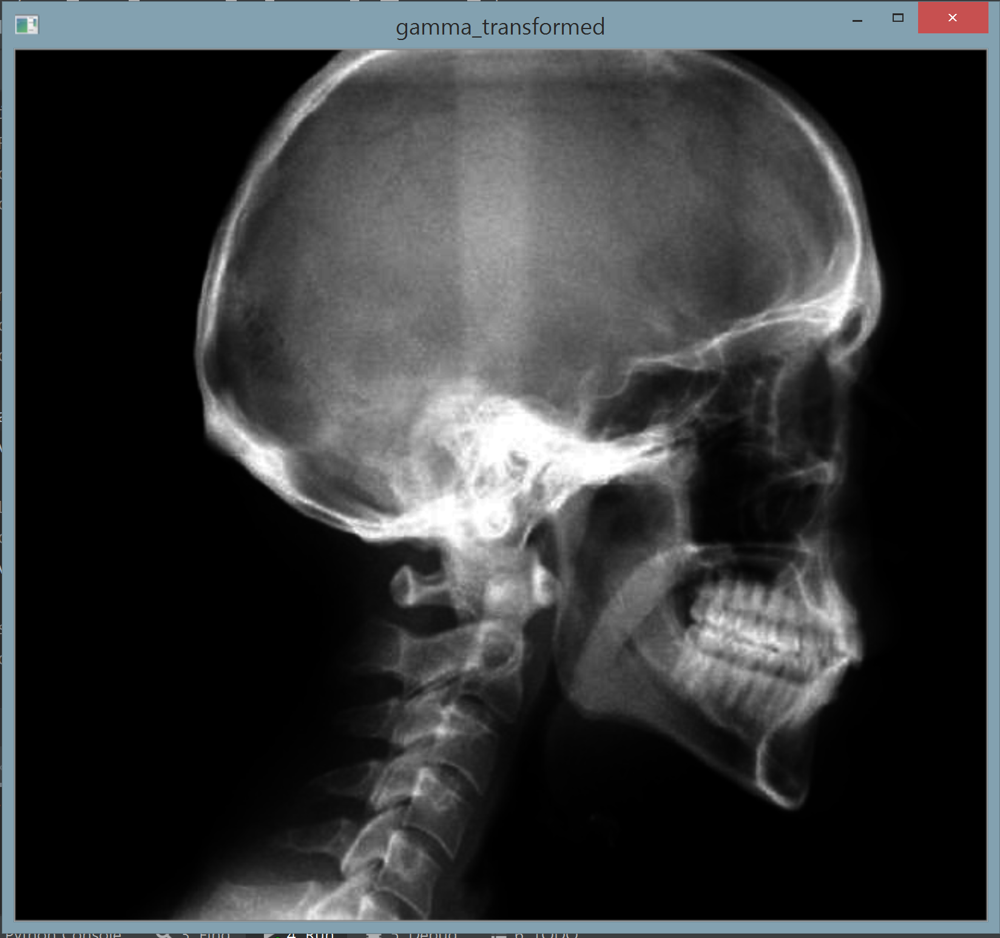
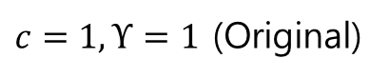
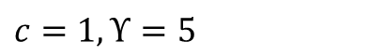
Intensity Transform –Gamma Transformation
Eg) MRI,X-ray
$c=1,Υ=1$ (Original)
$c=1,Υ=5$

Slide 13
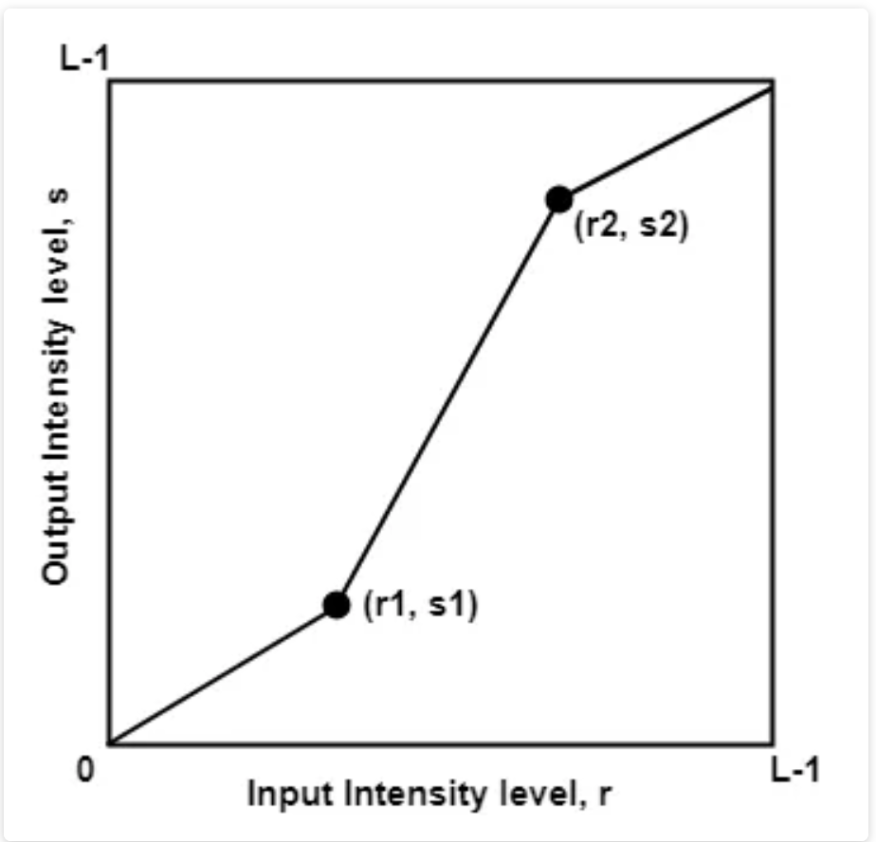
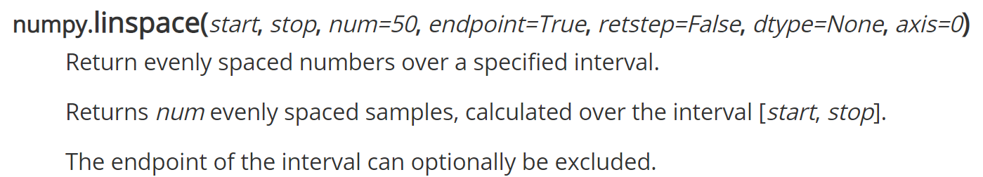
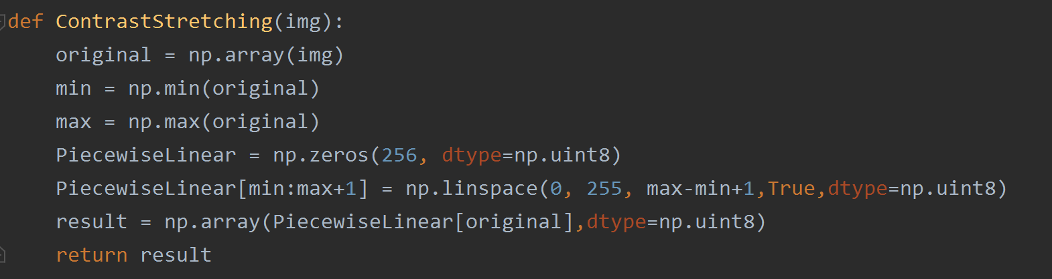
Intensity Transform –Contrast Stretching
When r1 =s1 and r2=s2,
transformation becomes a Linear function.
When (r1, s1) = (r_{min}, 0) and (r2, s2) = (r_{max}, L-1), this is known as Min-Max Stretching.
Using numpy.linspace (Piecewise Linear Function)
Max
stretching
Min
stretching

Slide 14
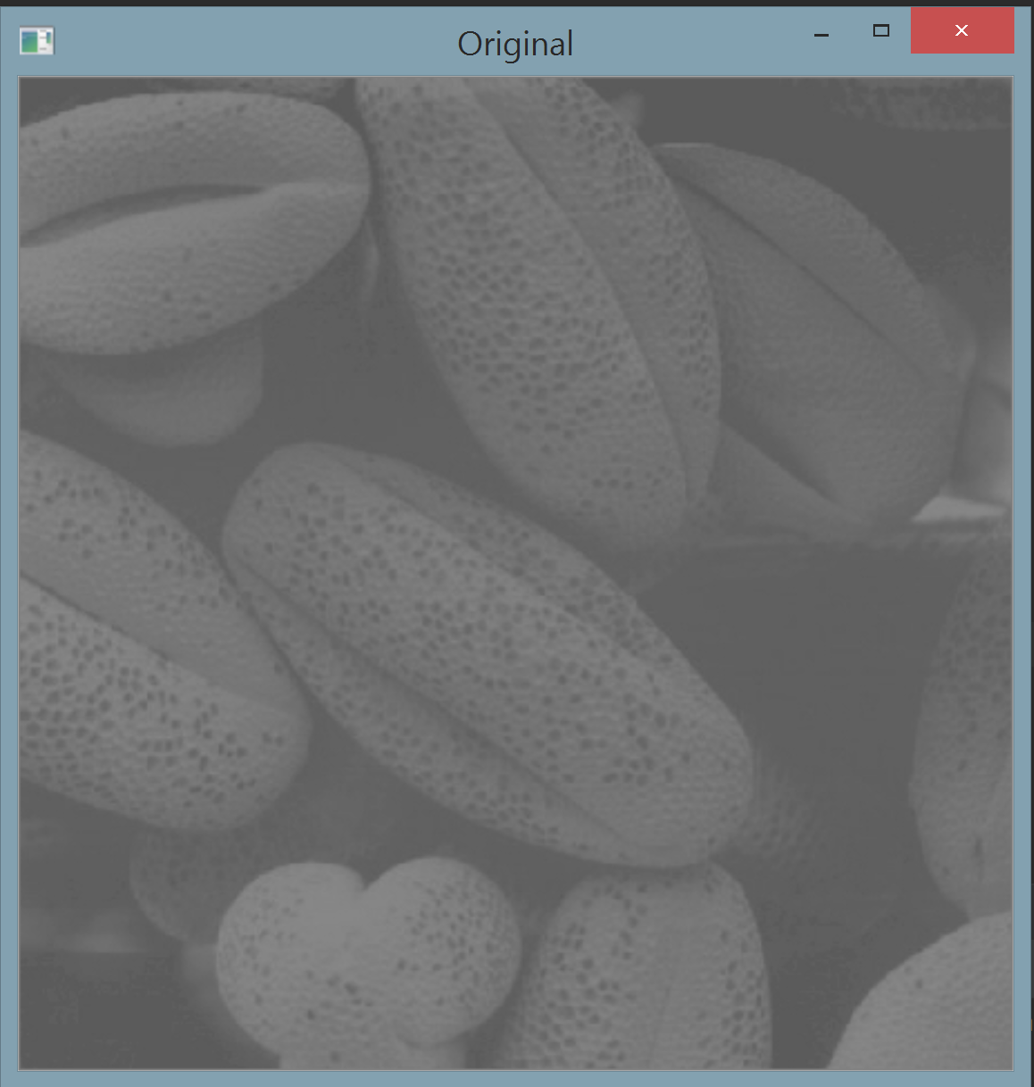
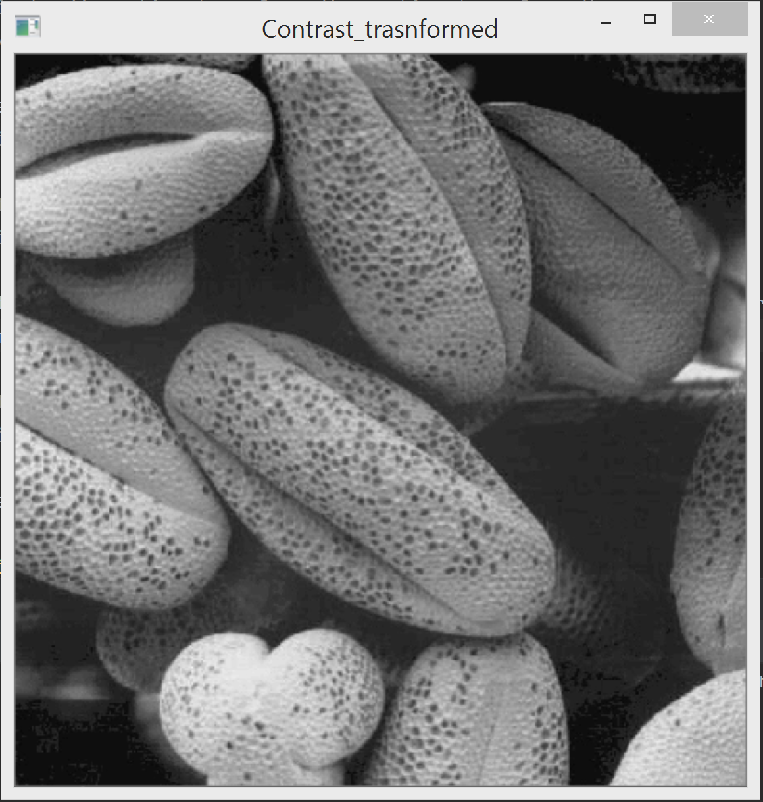
Intensity Transform –Contrast Stretching

Slide 15
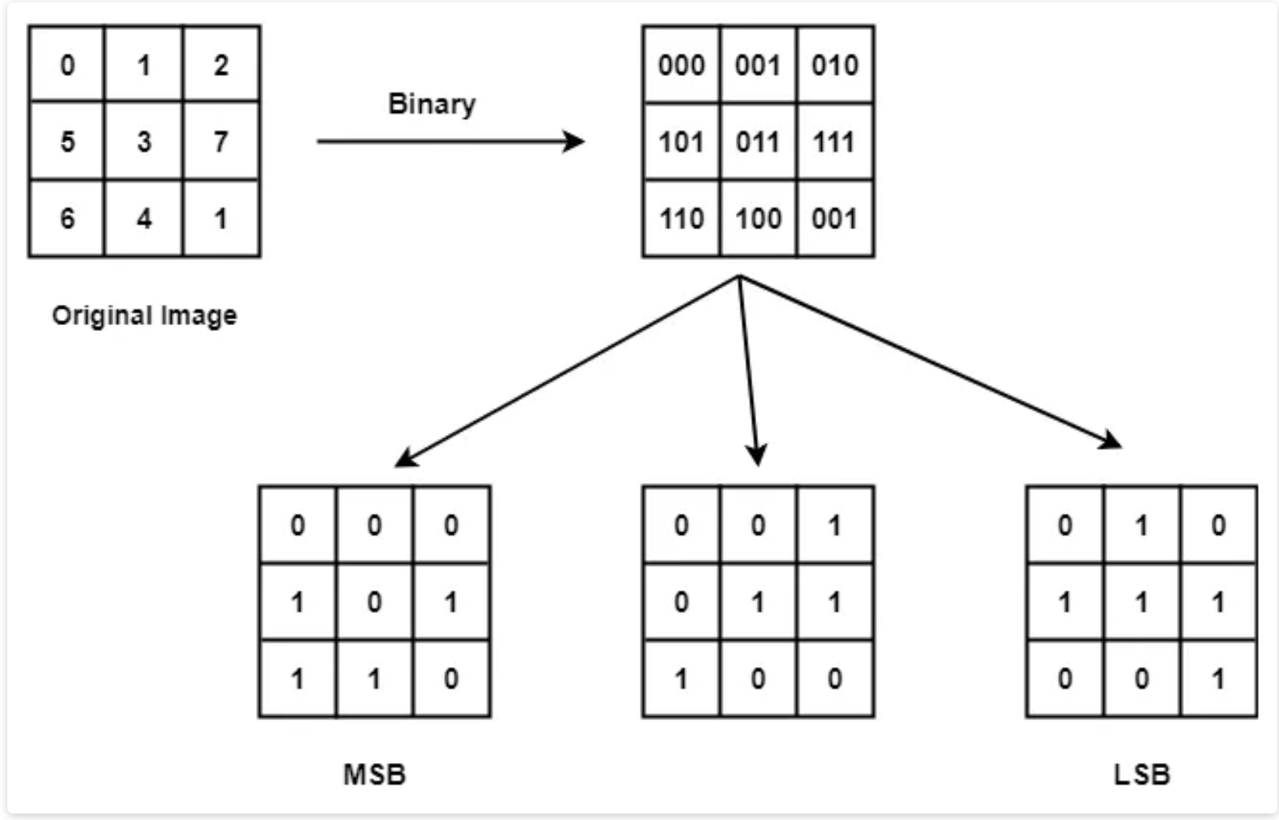
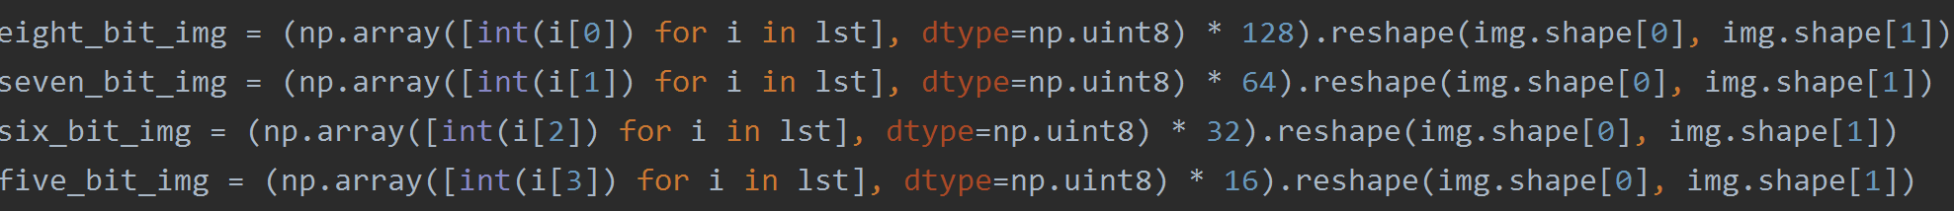
Intensity Transform – Bit Slicing

Slide 16
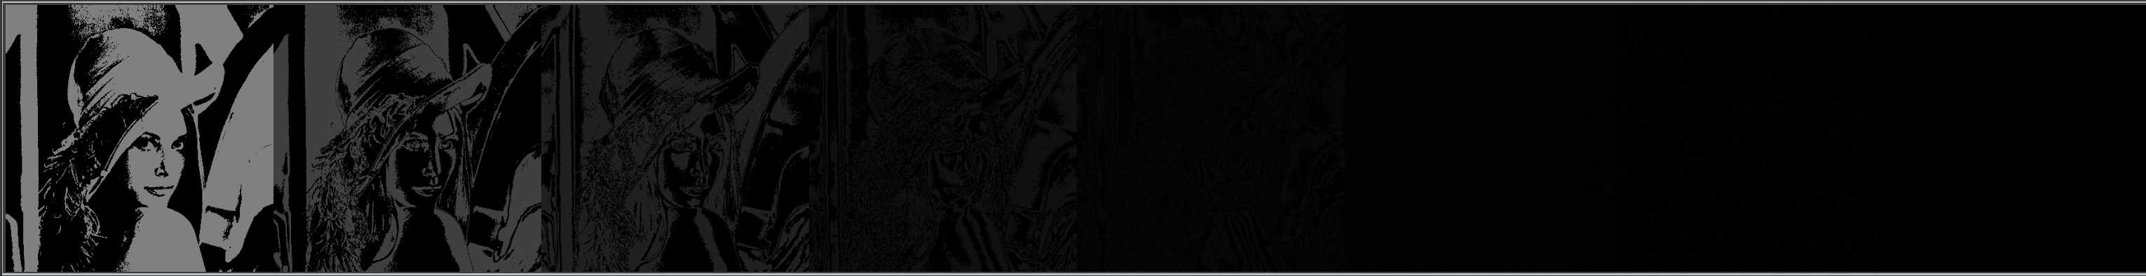
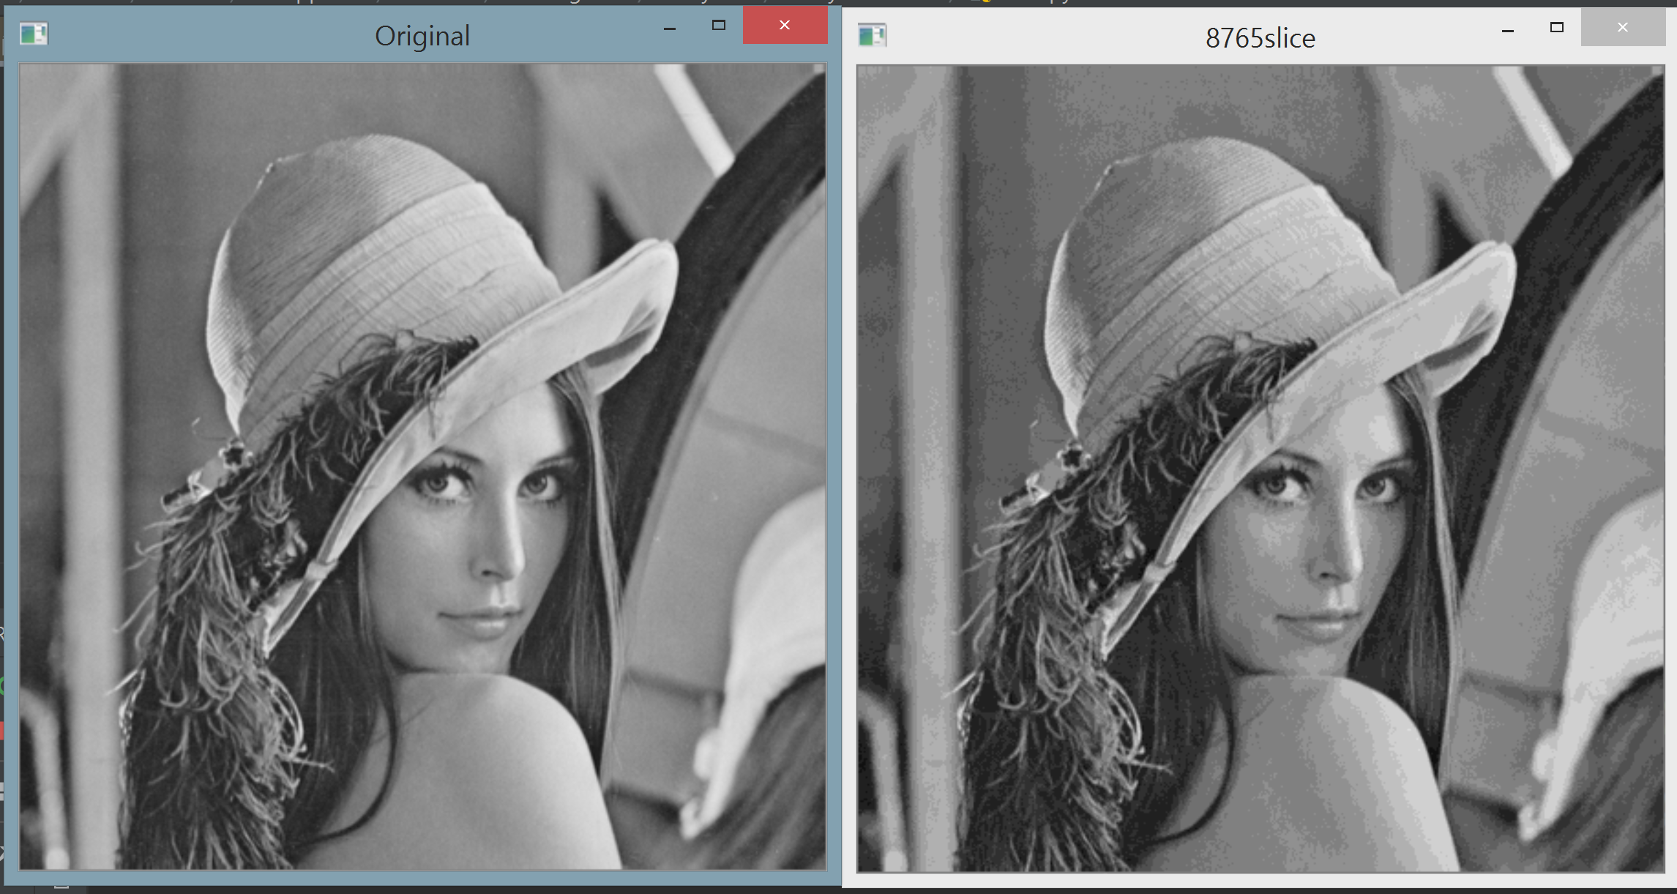
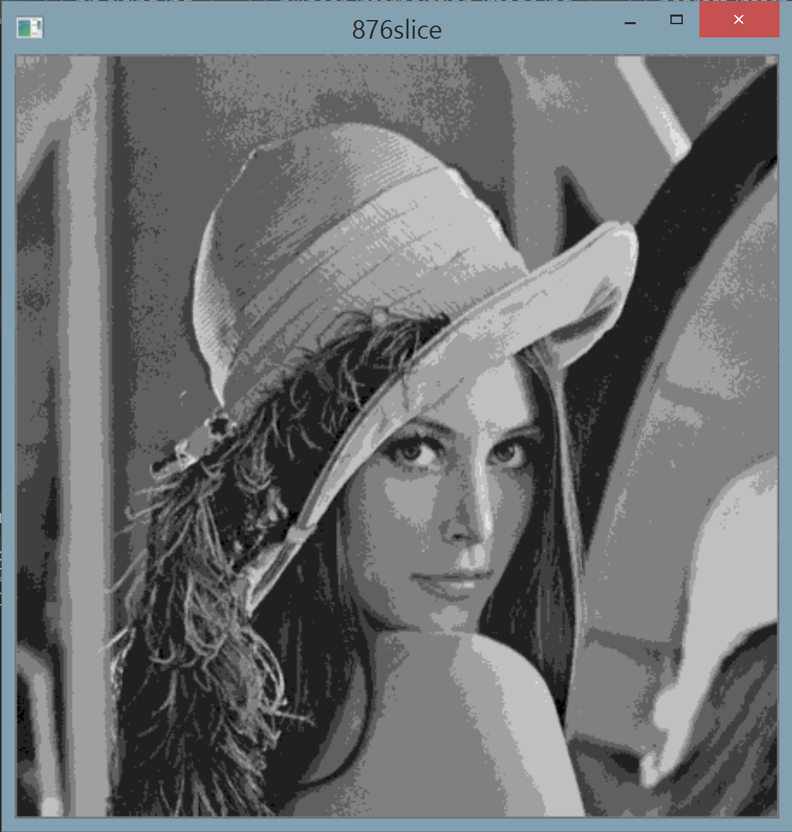
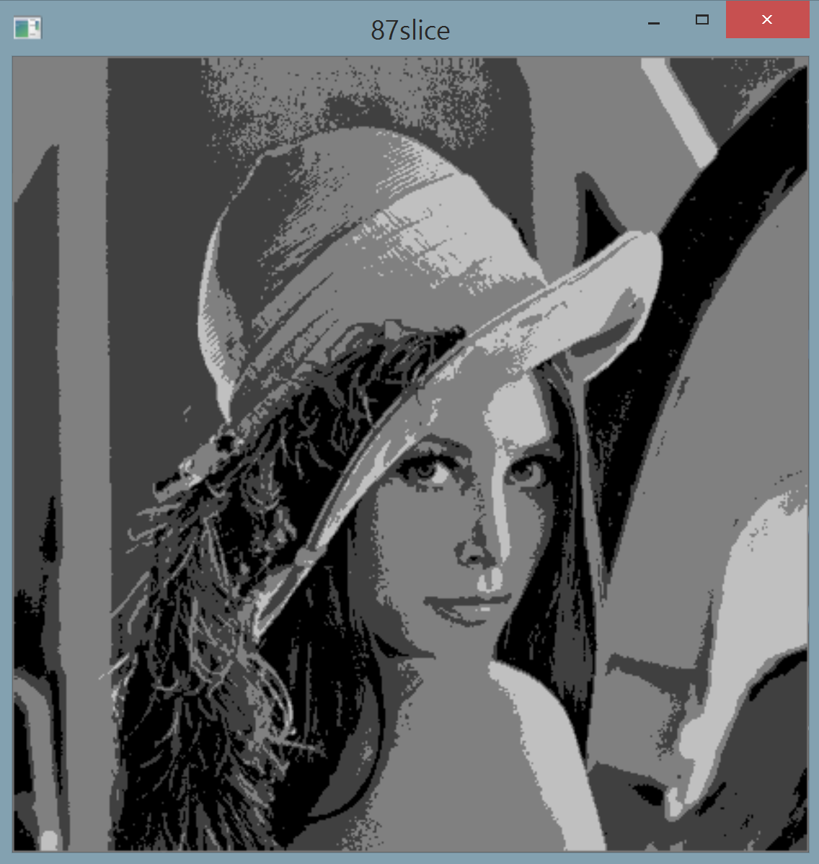
Intensity Transform – Bit Slicing

Slide 17
Intensity Transform – Bit Slicing
Benefit?
1.Image Compression (Constructing nearly the original image using less number of bits).
2.Through this, we can analyze the relative importance of each bit in the image
that will help in determining the number of bits used to quantize the image.

Slide 18
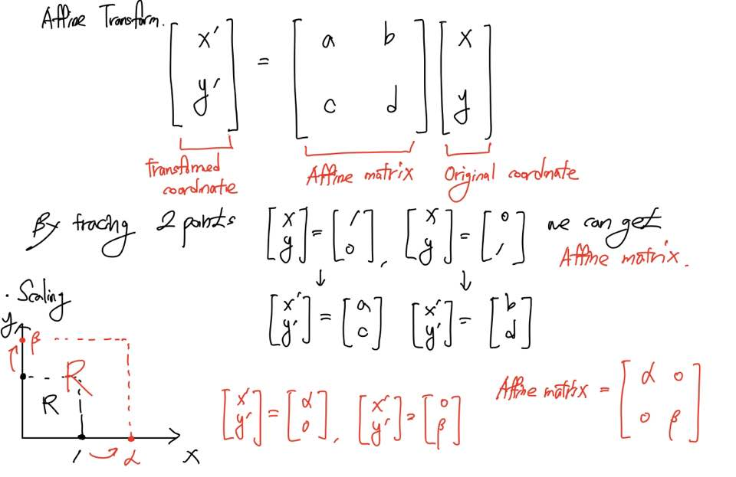
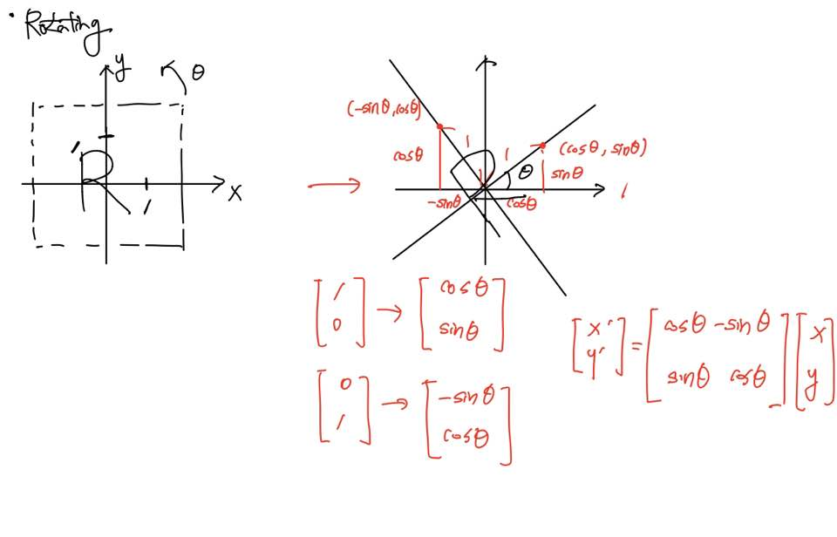
Affine Transform
Meaning: linear mapping method that preserves points, straight lines, and planes (in spatial domain)

Slide 19
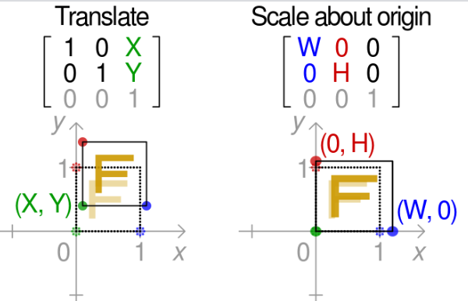
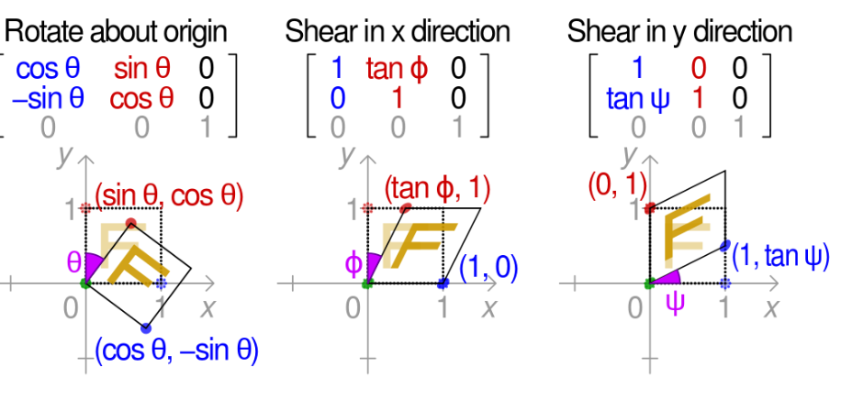
Affine Matrix

Slide 20
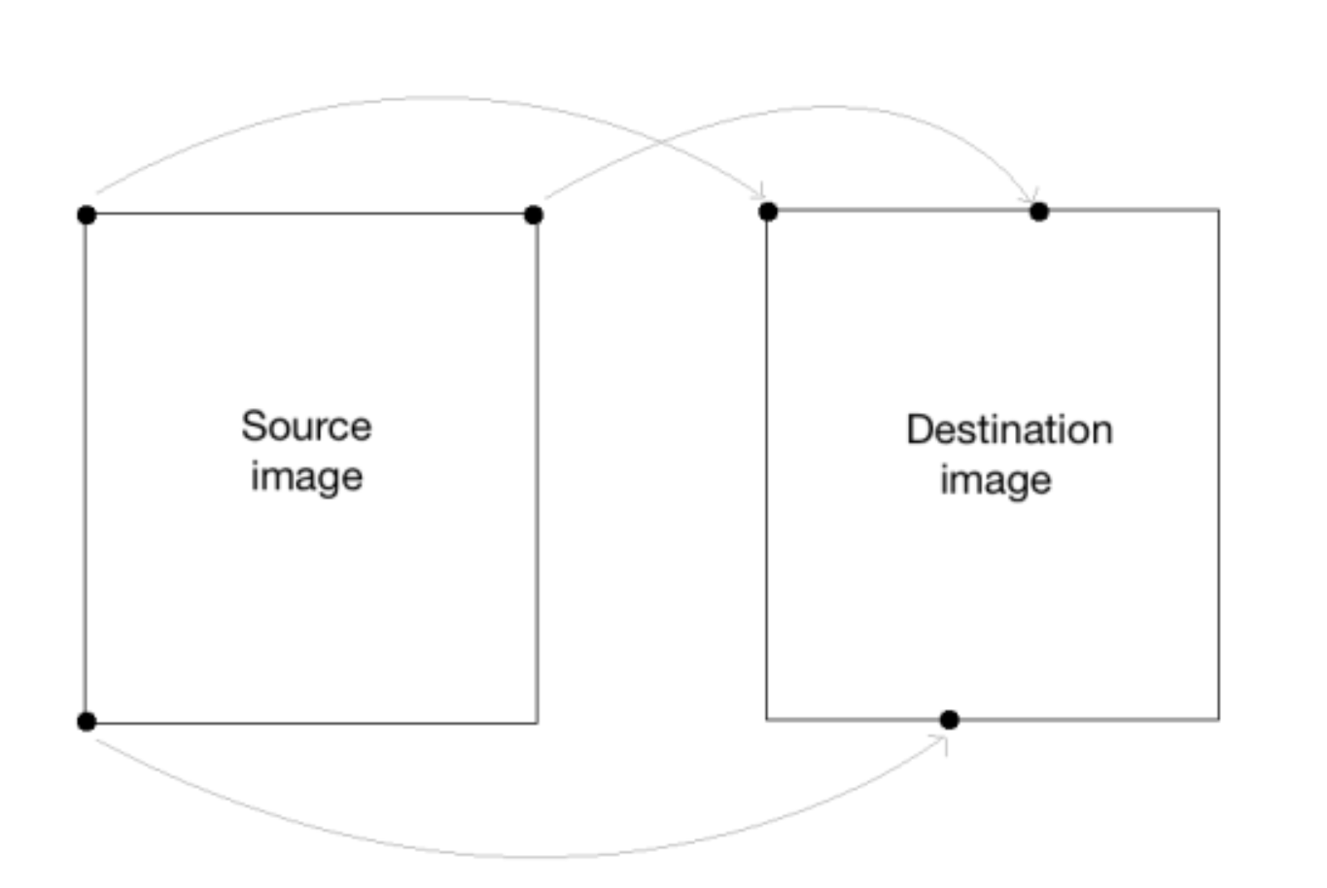
Problem by Discrete Coordination of Matrix
①If not integer
= No matching coordination
②If there is no one-to-one =correspondence coordination with Source and Destination matrix.

Slide 21
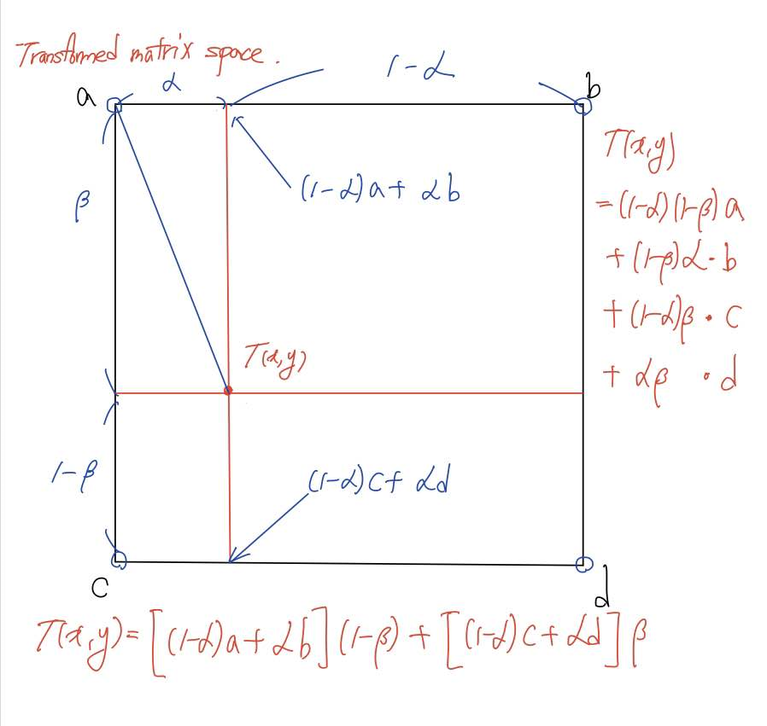
Bilinear Interpolation
Linearly Weighted Sum of 4 nearest pixel
Intensity

Slide 22
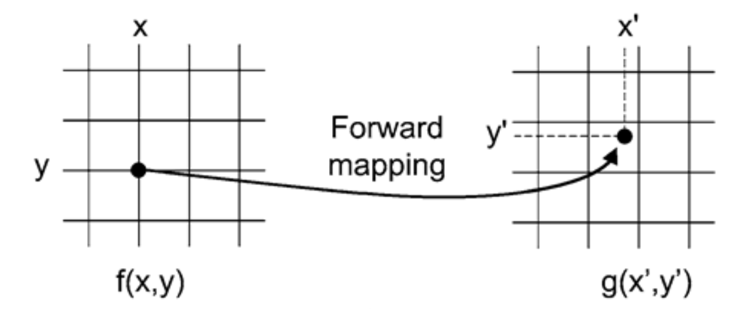

Mapping direction
Depending on specific spatial transform function, there is Two main problem of Forward mapping
-Gaps: Some output pixels that did not receive any input image pixels.
-Overlaps: Some output pixels can received more than one input image pixel
-Interpolation By using Original pixel’s information
-Every destination pixel can get own value.

Slide 23

Interpolation Exception (Code)
Exception for Edge(corner) integer coordination

Slide 24






Scaling
Considered in code
1. Corner to Corner correspondence
Image Scaling k times
-> Coordination Scaling $\frac{kN−1}{N−1}$ times
2. Interpolation Exception (for boundary)
3. Extracting Coordination by using
enumerate( np.array )
4. Scaling magnitude integer casting

Slide 25


Interpolation (Nearest, Bilinear)

Slide 26


Rotating
Considered in code
Deciding destination matrix scale
2. Backward pixel selection by casting
3. Zero padding with nonvalid elements

Slide 27




Light and color
Tristimulus values of eye
Light spectrum
CIE 1931 xy Color Space

Slide 28
Color model
Every color which human can see
Can be respresented in X,Y,Z color space.
X,Y,Z color space is independent with
Characteristic of device.
RGB color Space
Various color space (HIS, CMY, Ycbcr … ) in Various purpose
But there is no absolute color model
( we can’t make mathematical function of brain)

Slide 29


RGB color model
brightness

Slide 30



Ycbcr color model
Y= luminance
Cb , Cr = color Difference
Image compressing

Slide 31




CMY(K) color model
Color printer, copy machine

Slide 32




HSI color model
more “intuitive” in manipulating with color and were designed to approximate the way humans perceive and interpret color
H: Hue S : Saturation I : Intensity

Slide 33

Color Transformation RGB to Ycbcr

Slide 34

Color Transformation RGB to CMY

Slide 35

Color Transformation RGB to HSI

Slide 36
THANK YOU for your attention

